Slide 1
SQL Server R Services SQL Saturday #572 Vancouver, WA, October 22, 2016

Slide 2
About Me
Chris Hyde
Owner and Principal Consultant, Hydrate Consulting LLC
MCSA, MCITP
16+ Years experience with SQL Server
Contact Me:
Email: chris@hydrate.consulting, chrishyde325@gmail.com
Twitter: @ChrisHyde325

Slide 3

Before we begin…

Slide 4
What is this R you speak of?
“R is a language and environment for statistical computing and graphics.”
“R provides a wide variety of statistical and graphical techniques, and is highly extensible.”
“Many users think of R as a statistics system. We prefer to think of it of an environment within which statistical techniques are implemented.”
https://www.r-project.org/about.html

Slide 5
You got R in my SQL! No, you got SQL in my R!
Microsoft purchased Revolution Analytics in April 2015.
Revolution’s distribution of R was integrated in SQL Server 2016 under the name of SQL Server R Services.
First available in CTP 3.0.

Slide 6
But what can I do with R anyway?
Demo #1: Predicting free disk space

Slide 7
Why R?
Microsoft is positioning itself to be a leader in the field of Business Analytics.
Descriptive Analytics – what has already happened; traditional Business Intelligence
Predictive Analytics – what will happen in the future; data mining, predictive modeling
Prescriptive Analytics – suggesting actions based on the predictive models; the next data science buzzword?

Slide 8
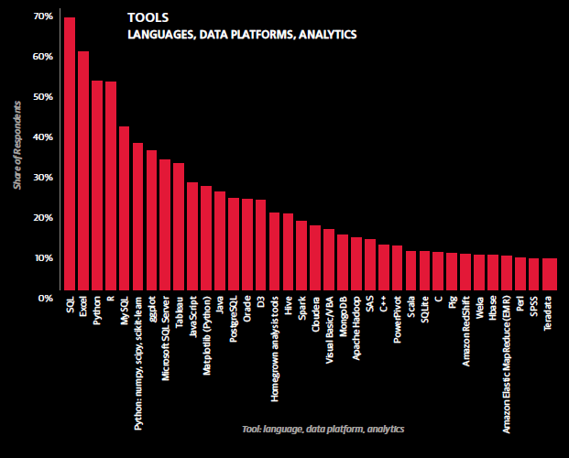
R as an Analytics Tool, part I
Source: O’Reilly Data Science Survey 2015

Slide 9
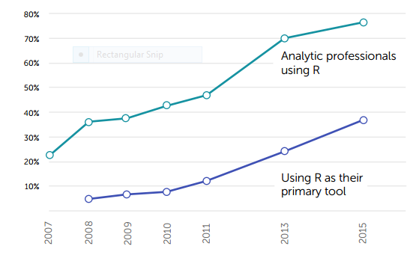
R as an Analytics Tool, part II
Source: 2015 Rexer Analytics Data Science Survey

Slide 10
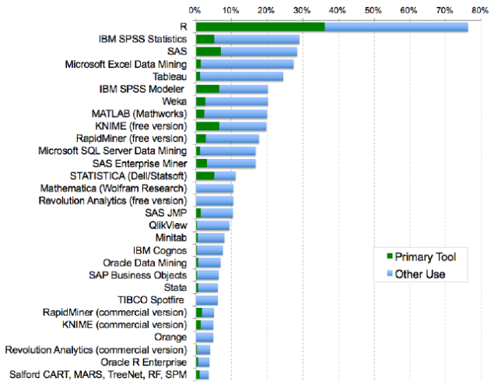
R as a Predictive Analytics Tool
Source: 2015 Rexer Analytics Data Science Survey

Slide 11
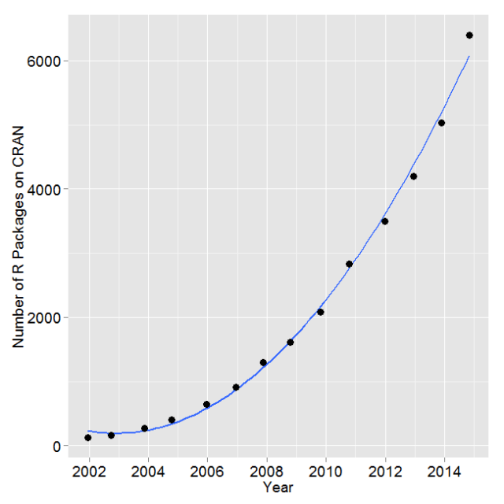
Exponential Growth of R Packages
Source: https://www.r-bloggers.com/on-the-growth-of-cran-packages/

Slide 12
Installing SQL Server R Services, part 1
1. Install Advanced Analytics Extensions
https://msdn.microsoft.com/en-US/library/mt590808.aspx

Slide 13
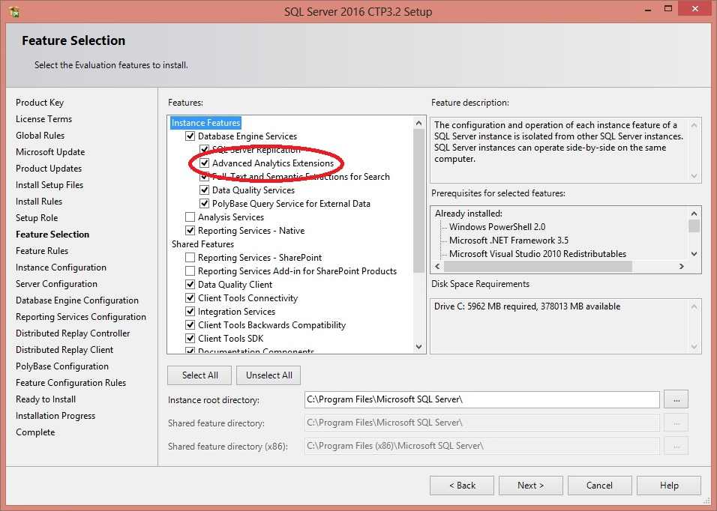
Installing SQL Server R Services, part 2

Slide 14
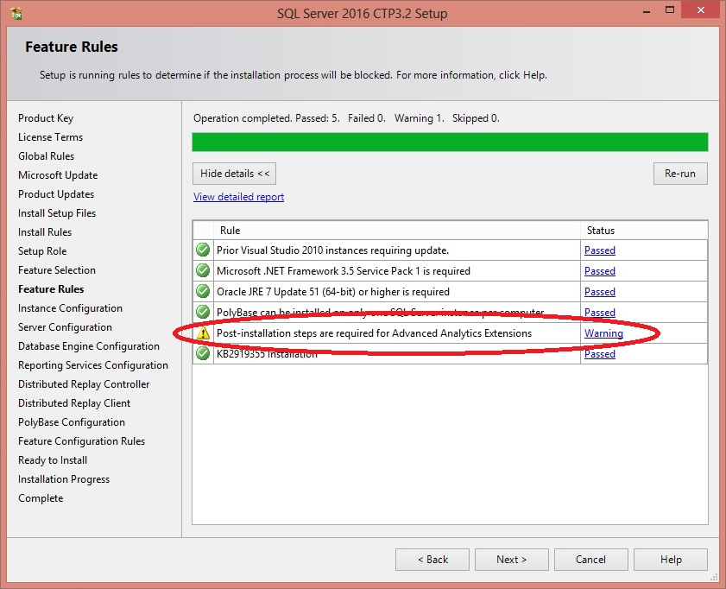
Installing SQL Server R Services, part 3

Slide 15
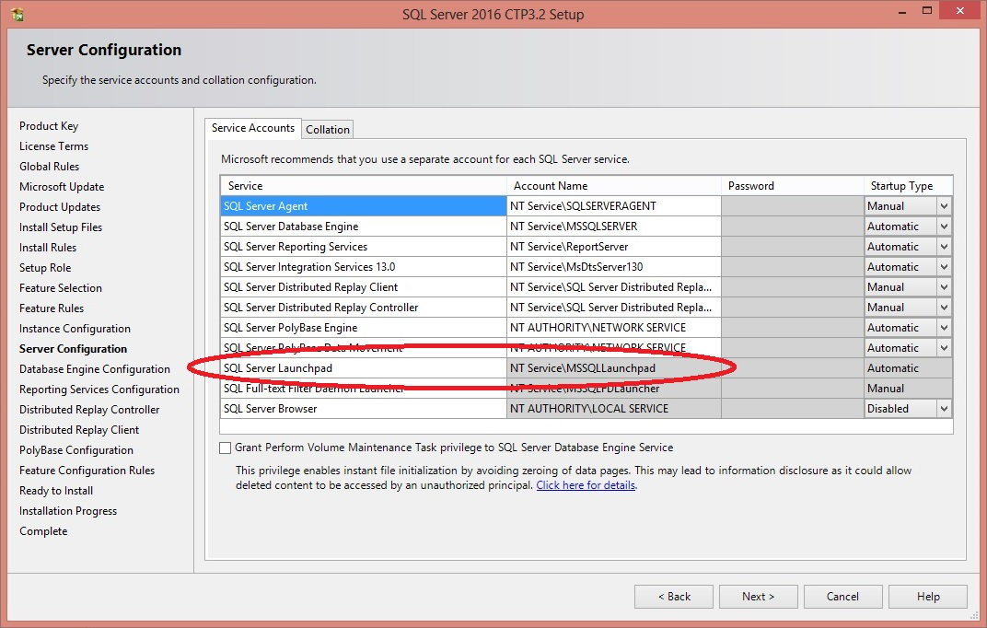
Installing SQL Server R Services, part 4

Slide 16
Installing SQL Server R Services, part 5
2. Install Revolution R Open 3.2.2 on database server
(R runtime engine)
3. Install Revolution R Enterprise 7.5 on database server
(R platform)
https://msdn.microsoft.com/en-US/library/mt590809.aspx

Slide 17
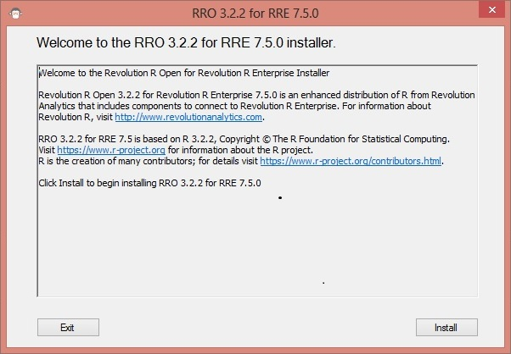
Installing SQL Server R Services, part 6

Slide 18
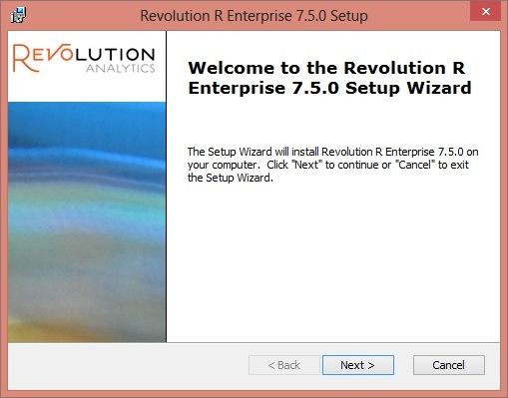
Installing SQL Server R Services, part 7

Slide 19
Installing SQL Server R Services, part 8
Post-installation scripts and configuration
1. Enable external scripts
EXEC sp_configure 'external scripts enabled', 1;
RECONFIGURE;
2. Configure memory appropriately
3. Post-installation command script
https://msdn.microsoft.com/en-US/library/mt590536.aspx

Slide 20
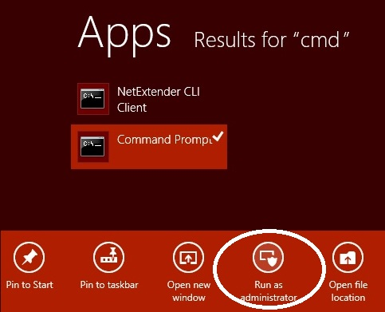
Installing SQL Server R Services, part 9

Slide 21
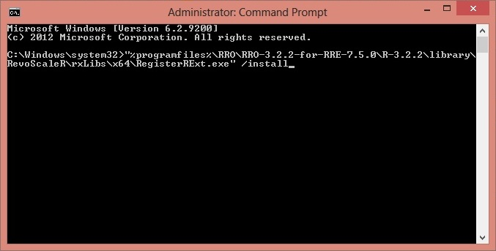
Installing SQL Server R Services, part 10

Slide 22
Basic Concepts of R, part 1
The assignment operator: x <- 1;
Sequences: 1:10 A:Z
Vectors: n <- 1:10; letters <- A:Z; x <- 1;
Combiner: fib <- c(1, 1, 2, 3, 5, 8, 13);
Data Frames

Slide 23
Basic Concepts of R, part 2
Vectorized Operations:
x <- 1:6;
y <- x + 3;
(4, 5, 6, 7, 8, 9)
x <- 1:6;
y <- 7:12;
z <- x + y;
(8, 10, 12, 14, 16, 18)
x <- 1:6;
y <- 7:9;
z <- x + y;
(8, 10, 12, 11, 13, 15)

Slide 24
Getting Data Into and Out Of R
Demo #2

Slide 25







The Case Studies (Slightly Fictionalized)
My Fictional Hospital
MFH

Slide 26
A Real-World Example
Demo #3: Averting panic over a charge summary report

Slide 27
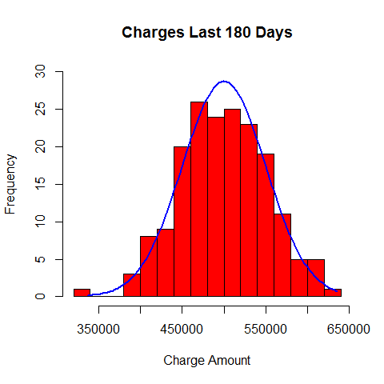
Distribution of Charges

Slide 28
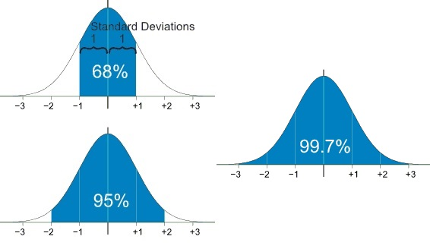
Reviewing Standard Normal Distribution
Source: https://www.mathsisfun.com/data/standard-normal-distribution.html

Slide 29
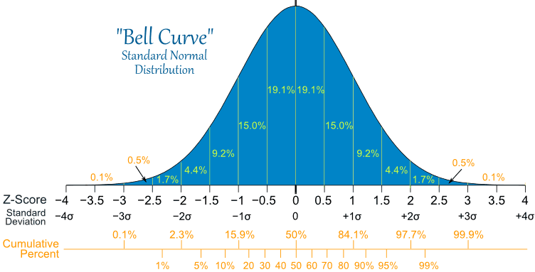
Standard Normal Distribution in Detail
Source: https://www.mathsisfun.com/data/standard-normal-distribution.html

Slide 30

Standard Deviation Formula
Source: https://www.mathsisfun.com/data/standard-deviation-calculator.html

Slide 31
A More Complicated Real-World Example
Demo #4: Overbooking without over-overbooking

Slide 32
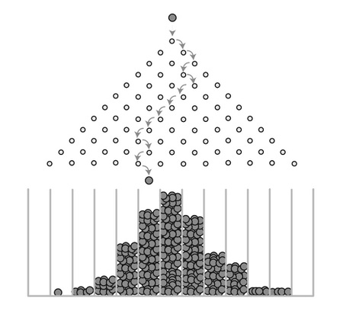
Galton Board

Slide 33
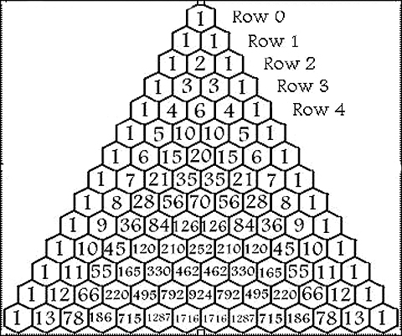
Pascal’s Triangle

Slide 34
Resources and Next Steps
This Presentation:
https://github.com/DrJekyll325/SQLServer/tree/master/Presentations/
Microsoft Data Exploration and Predictive Modeling Tutorial:
https://msdn.microsoft.com/en-us/library/mt591995.aspx
Coursera Data Science Specialization:
https://www.coursera.org/specializations/jhu-data-science
Email Me:
chris@hydrate.consulting
chrishyde325@gmail.com

